Slide 1


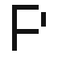




Neural network optimisation for accuracy, speed and profit
Andrey Ustyuzhanin

Slide 2
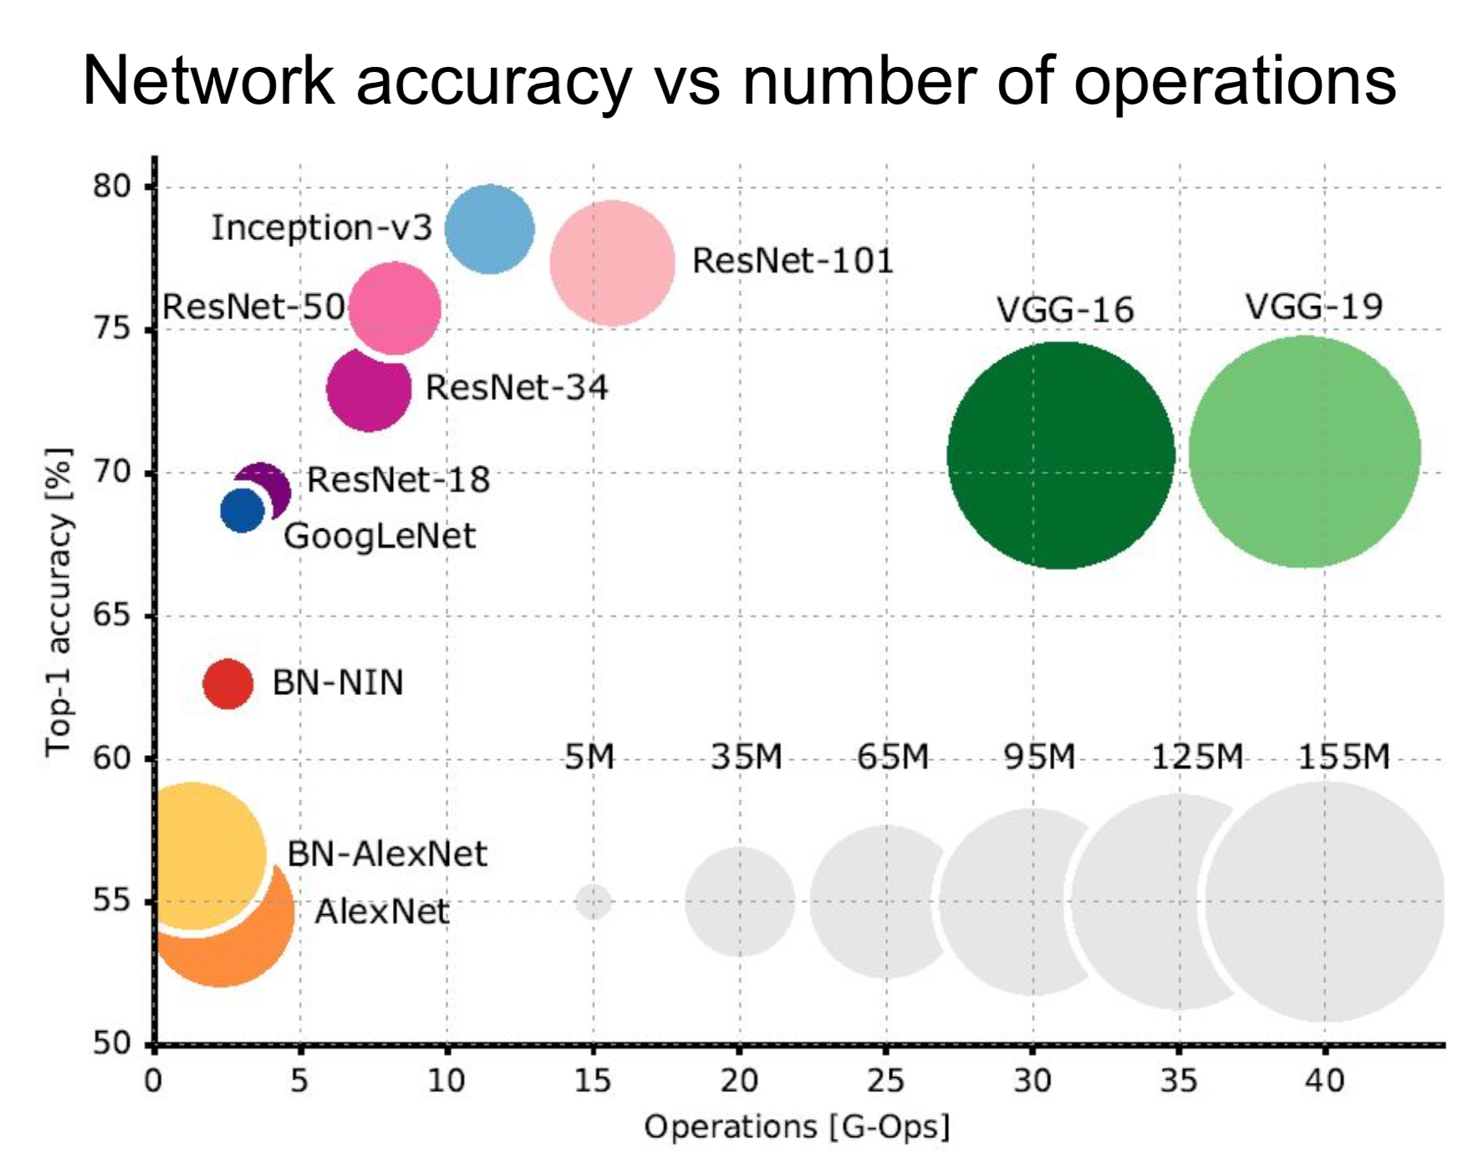
Why bother with optimisation?
Accuracy
Compression (space, speed, bandwith, energy):
Smart architectures (SqueezeNet, MobileNets)
Low-rank factorization, hashing trick, ...
Pruning
Reducing numerical precision
Distillation
Source: Canziani, A., Paszke, A., & Culurciello, E. (2016). An Analysis of Deep Neural Network Models for Practical Applications. arXiv preprint arXiv:1605.07678v2

Slide 3
Outline
Hyper parameter optimization
- sampling
- parallelisation
Neural network architecture search
Bayesian neural network perspective

Slide 4
Hyper parameter optimisation

Slide 5
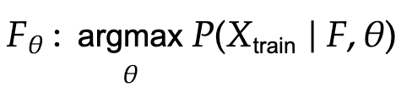
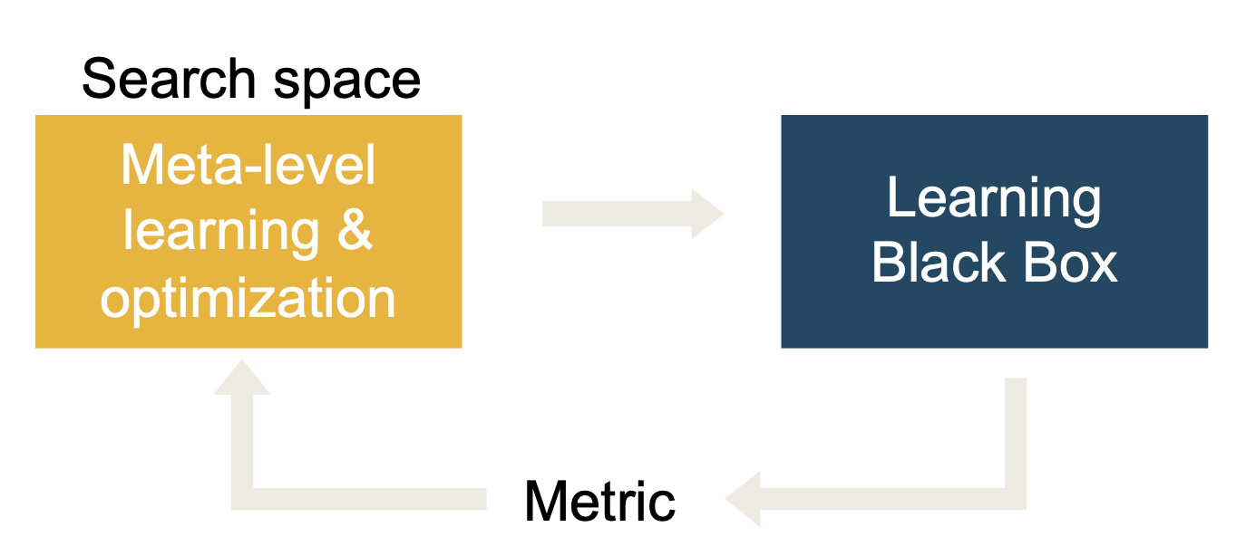
Classic Machine Learning approach
Classic ML idea – maximum likelihood:
pointwise estimation of trainable parameters at given configuration.
However, there is always set of parameters, that define F, so we can repeat argmax over and over…

Slide 6
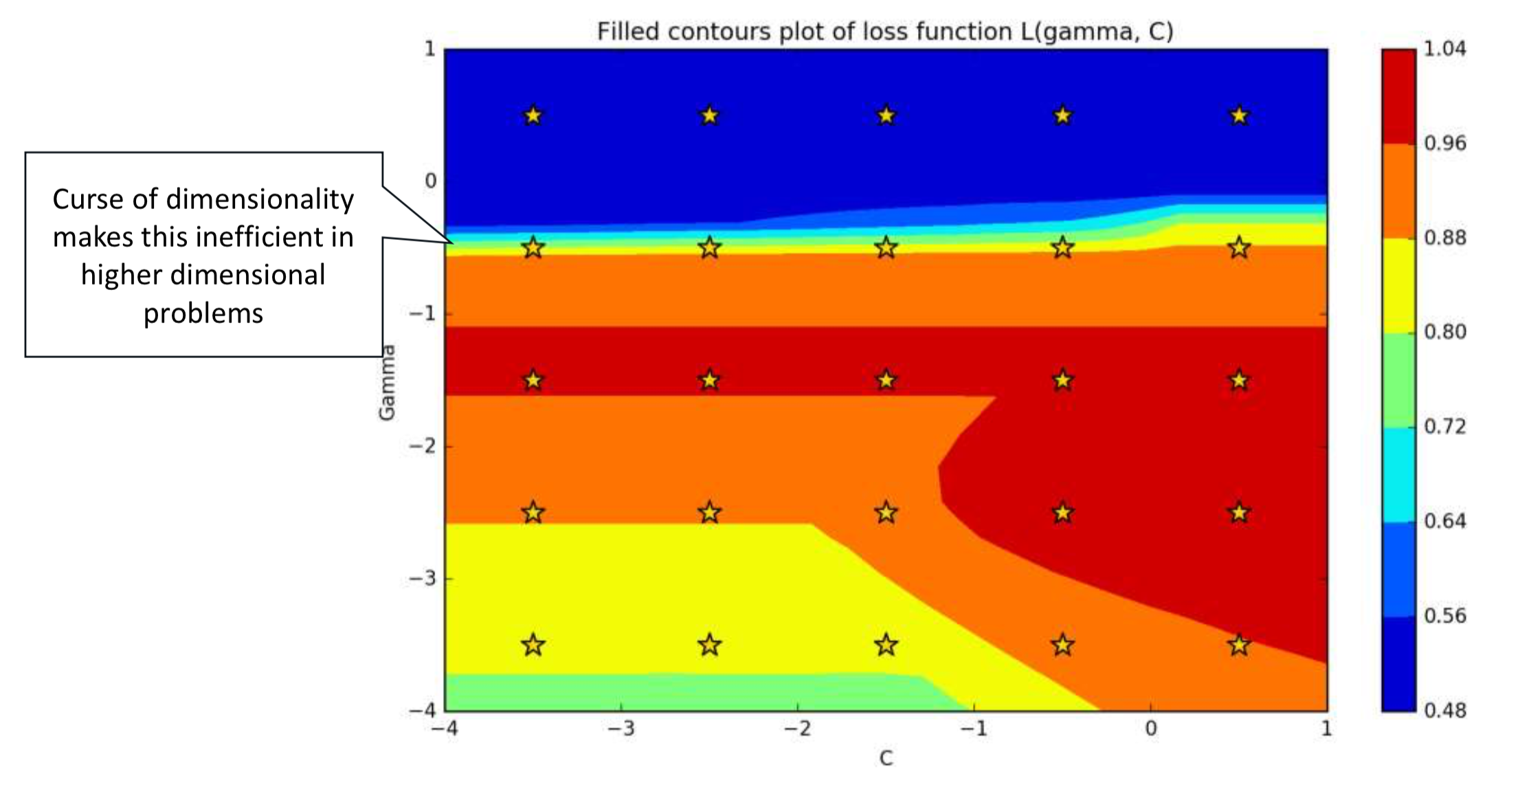
Scikit-Learn optimization classes
sklearn.model_selection.GridSearchCV(estimator, param_grid)

Slide 7
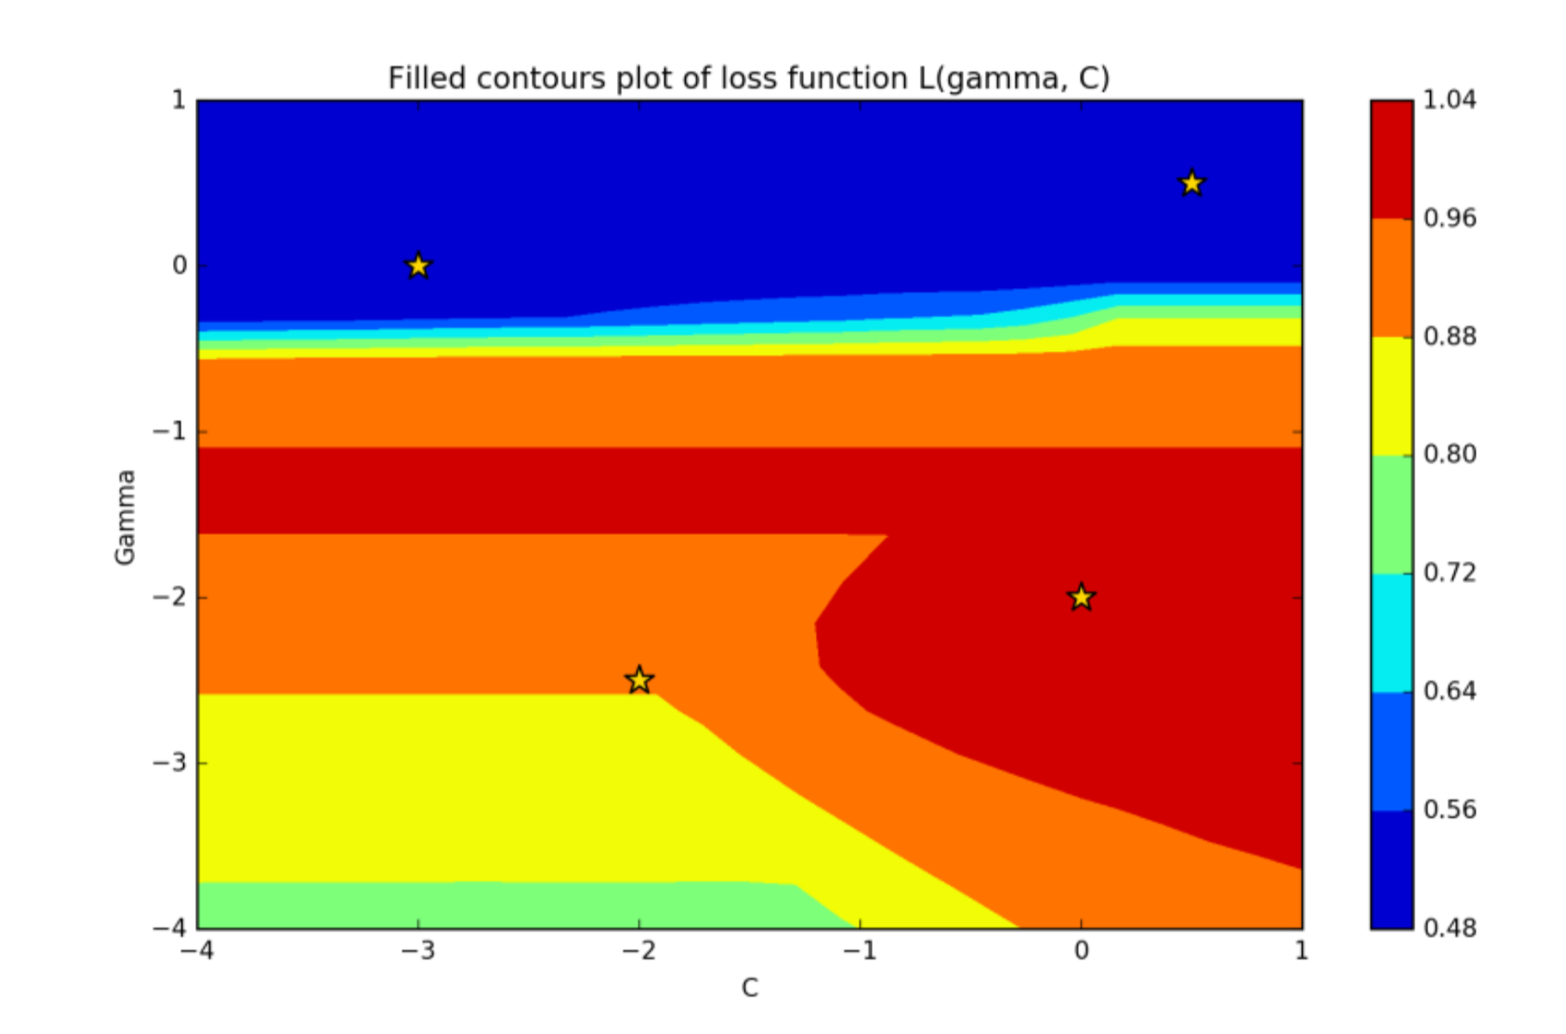
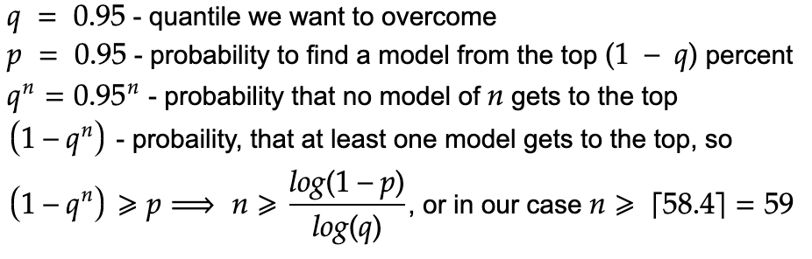
Scikit-Learn optimization classes
sklearn.model_selection.RandomizedSearchCV(estimator, param_distributions, n_iter, scoring)
“If at least 5% of the points on the grid yield a close-to-optimal solution, then random search with 60 trials will find that region with high probability.” Alice Zheng
Also see: fhttps://bit.ly/40abqDv

Slide 8
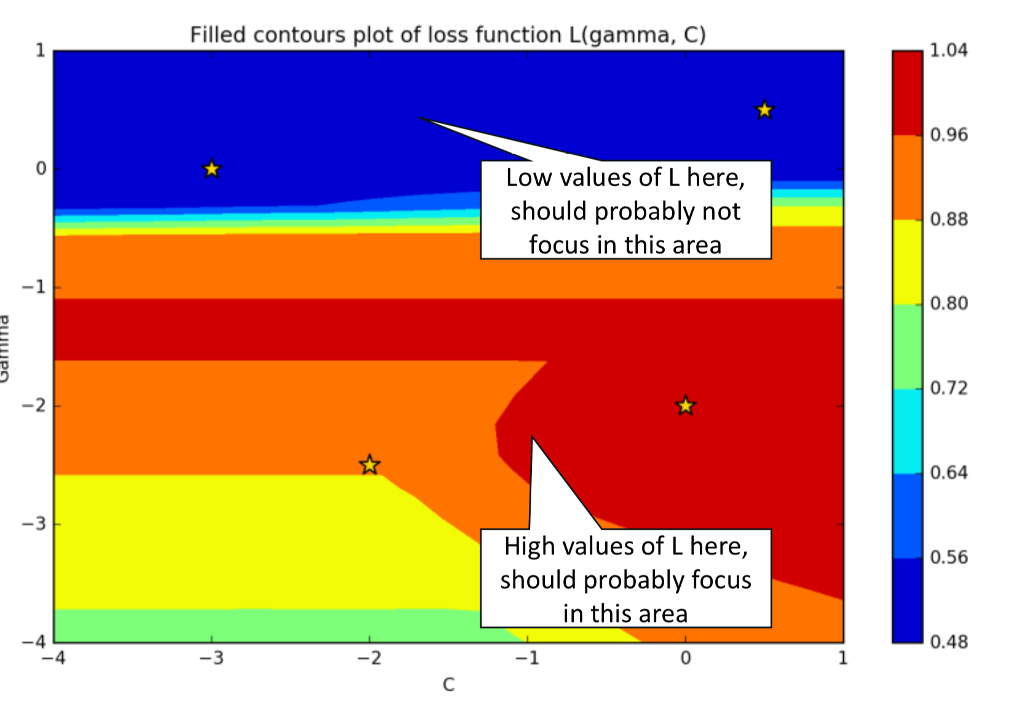
Towards Bayesian optimisation
However, both methods: GridSearch and RandomSearch are brute force approaches that scale poorly with the number of hyperparameters.

Slide 9
Why ‘Bayesian’ search?
Operates with sample distributions
Bayesian inference
Iteratively updates posterior distribution given prior and observations

Slide 10
Conditions
f is a black box for which no closed form is known (nor its gradients);
f is expensive to evaluate;
and evaluations of y = f (X) may be noisy.

Slide 11
Bayesian optimization cycle
Define family of f(x) , approximated by a surrogate model, defined by Θ and some prior for it
Estimate probability of finding maximum of f at x : a(x)
Update Θ for surrogate model conditional prob.
Measure f at argmax(a(x))

Slide 12
Surrogate models
Gaussian process Regression
Random Forest Regression
GBDT Regression
NN Regression

Slide 13
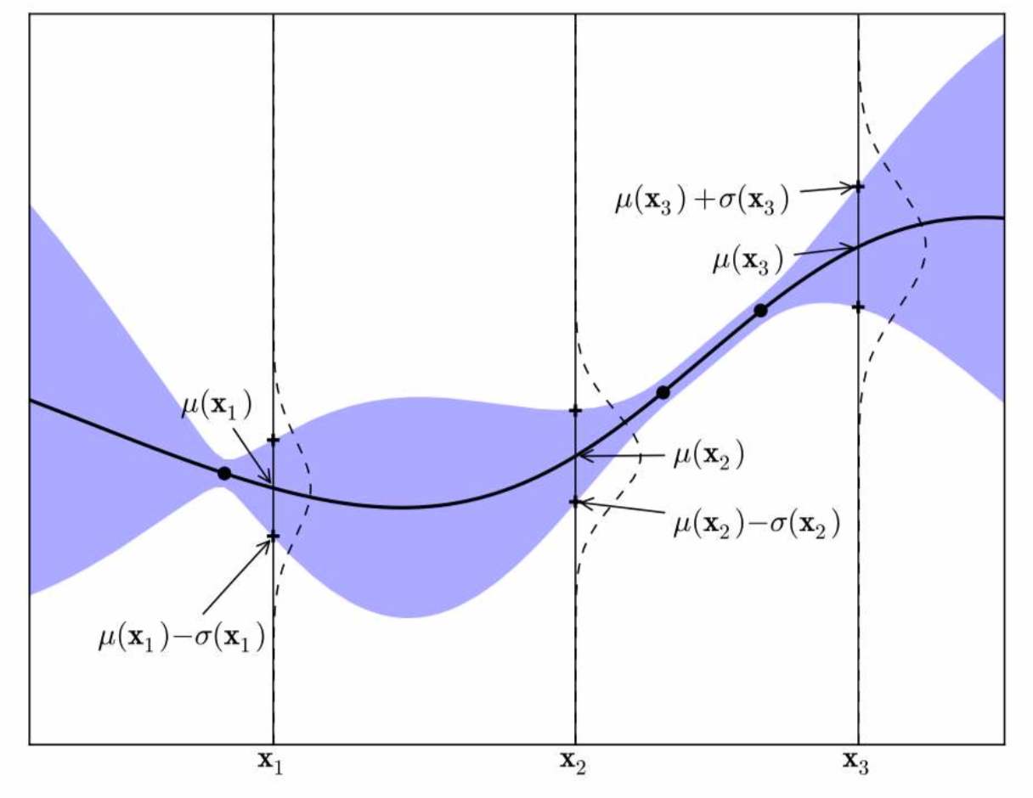
Gaussian Process (GP) model
Like a Gaussian defines distribution of variables (tensors), GP defines distribution of functions:
For every x, defines mean μ(x) and variance σ(x)
http://www.tmpl.fi/gp/
GP F is determined by Θ: covariance matrix from X + kernel

Slide 14
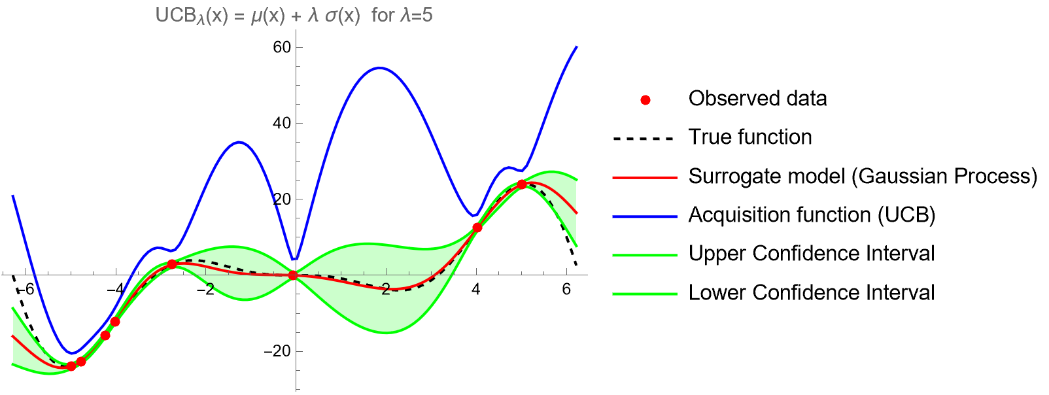
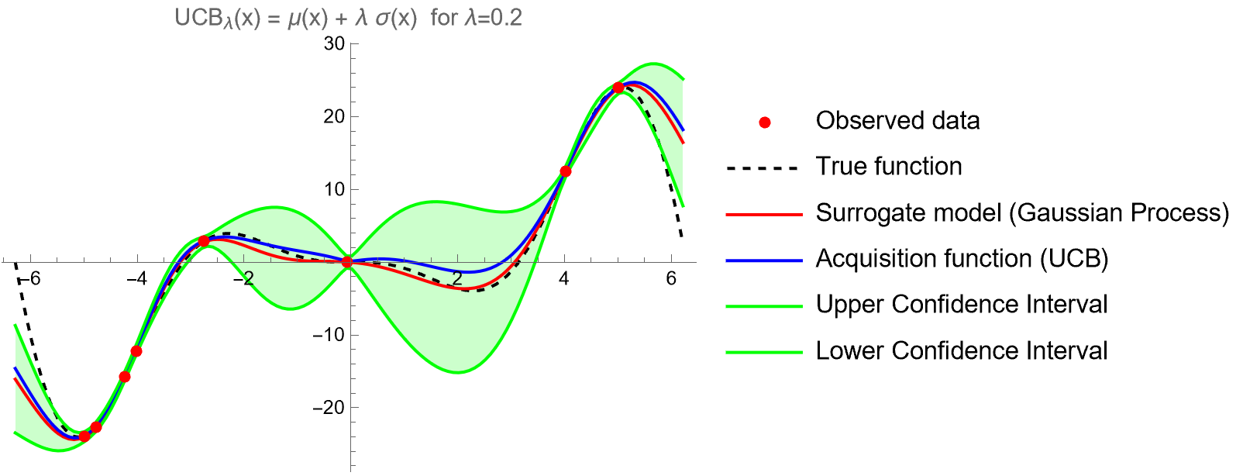
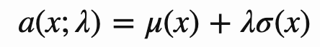
Next best candidate selection: upper confidence bound
Next x is taken at argmax of UCB_{ƛ}(x)

Slide 15
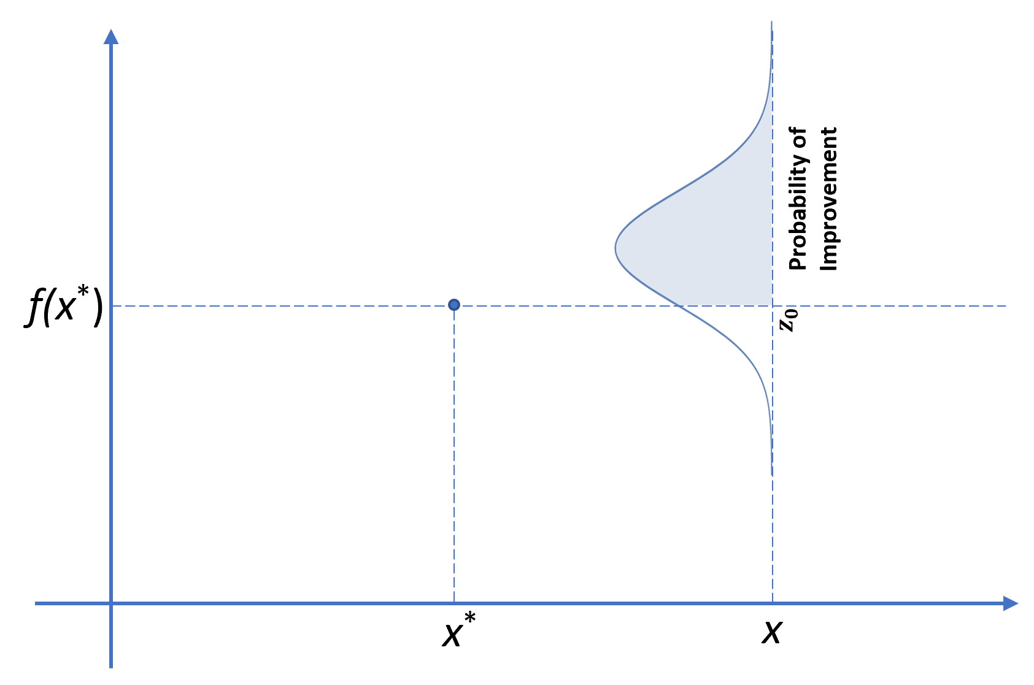
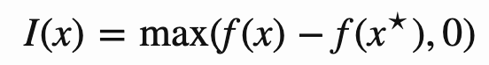
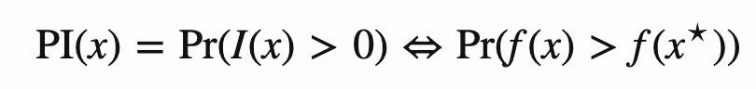
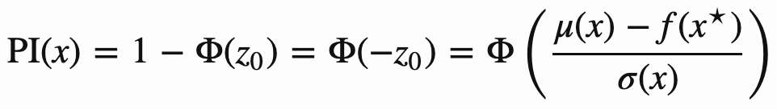
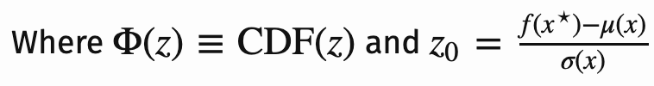
Next best candidate selection: Probability of Improvement
Suppose that we’d like to maximize f(x), and the best solution we have so far is x⋆. Then, we can define “improvement”, I(x), as

Slide 16
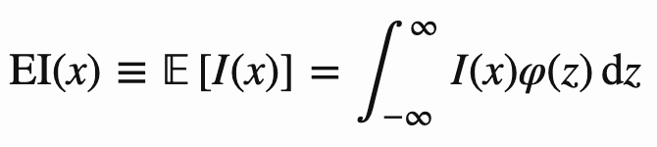
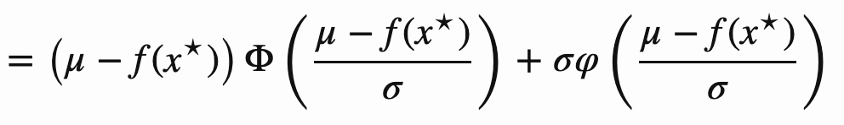
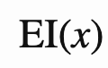
Next best candidate selection: Expected Improvement
PI considers only the probability of improving our current best estimate, but it does not factor in the magnitude of the improvement. This is where the expected improvement acquisition function is different. Instead of looking at the improvement I(x), which is a random variable, we instead calculate the “Expected Improvement”:
Where φ(z) is the probability density function of the normal distribution N(0,1)

Slide 17
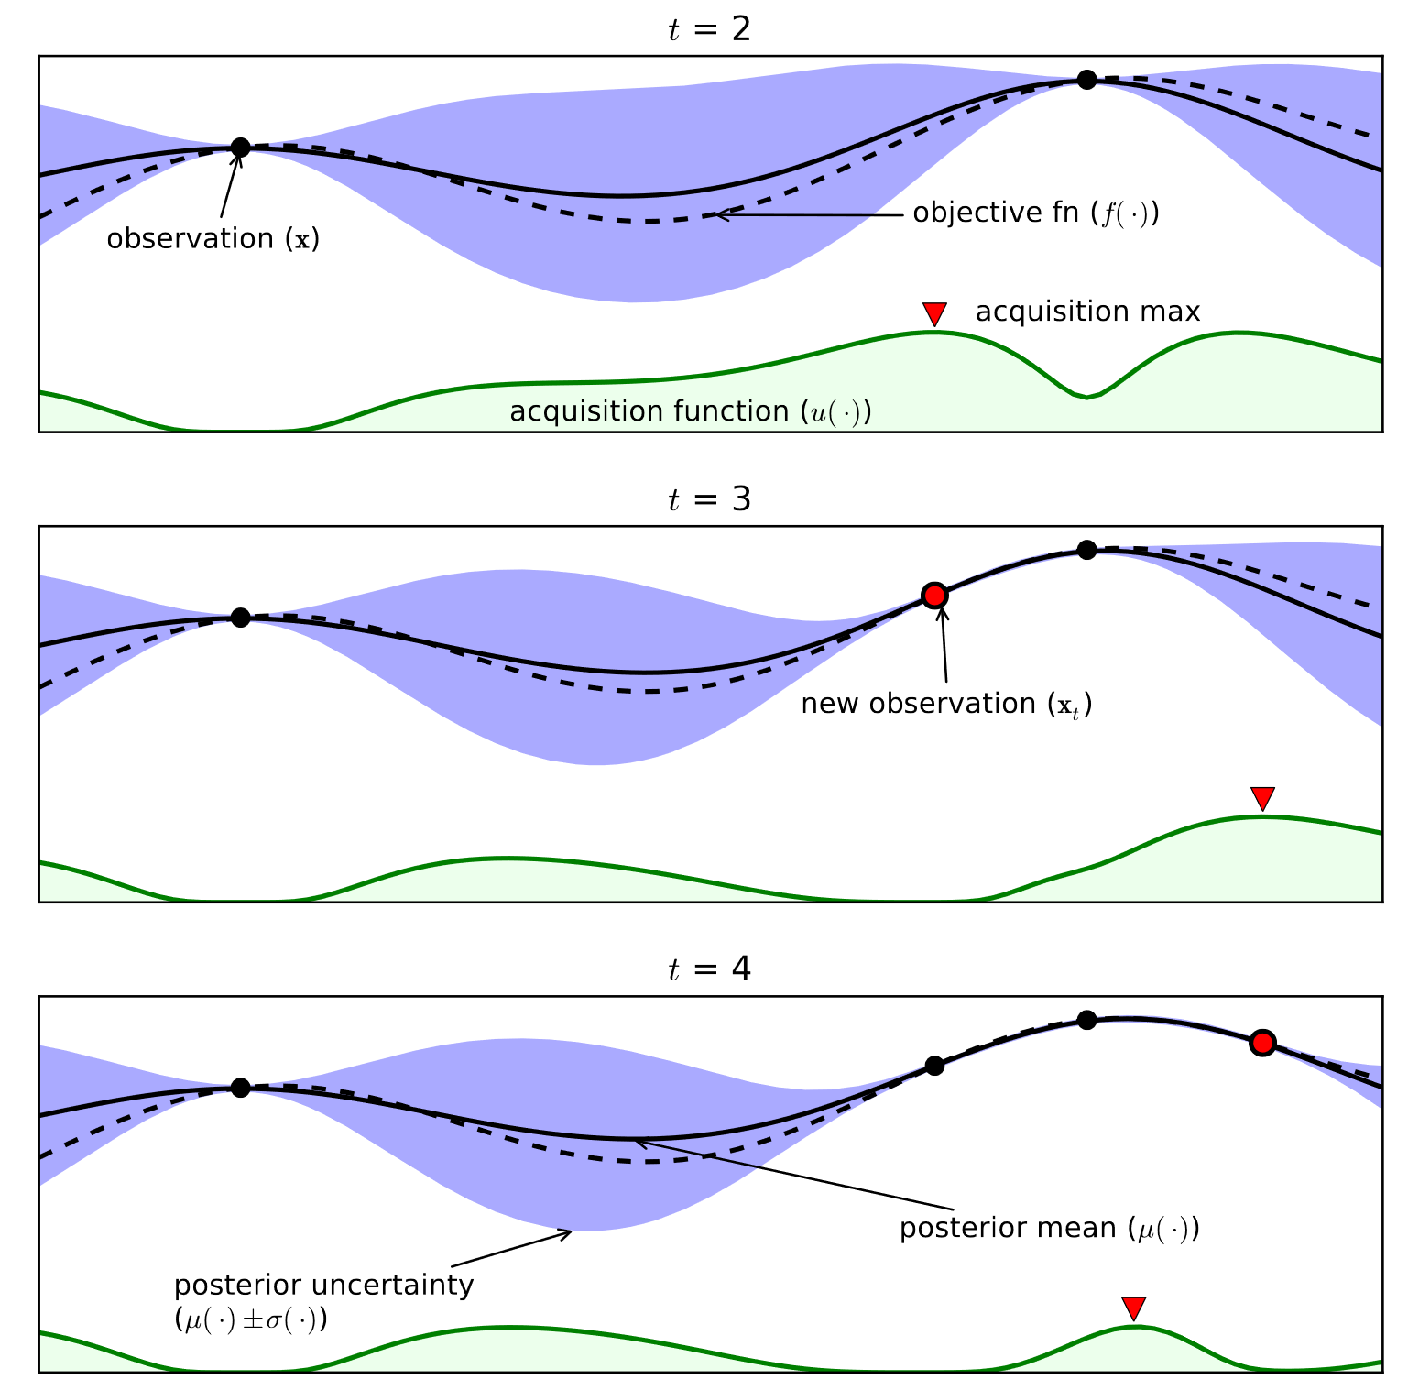
Illustration for 1D
Here is an example of a Gaussian Process along with a corresponding acquisition function. This is a 1-dimensional optimization problem, but the idea is the same for more variables. The black dots are our measurements. The black dotted line is the objective function, and the black solid line is our surrogate model of it, (our posterior Gaussian Process). The blue shaded area represents the uncertainty of our surrogate model, σ(x). The green line is the acquisition function, which informs us what point x to sample next.
https://bit.ly/3UJZOpB

Slide 18
Bayesian optimization cycle
Define family of f(x) , approximated by a surrogate model, defined by Θ and some prior for it
Estimate probability of finding maximum of f at x : a(x)
Update Θ for surrogate model conditional prob.
Measure f at argmax(a(x))

Slide 19
<Bayesian optimization demo>

Slide 20
Discussion
Applicable to network optimisation: number of layers, number of neurons, activation function, etc.
Hyper parameter search is immediate step towards meta-learning
No gradients are available
Should account for stochasticity
Choose an appropriate prior for the hyperparameters sampling: For parameters like a learning rate, or regularization term, it makes more sense to sample on the log-uniform domain, instead of the uniform domain
Choose the kernel for the Gaussian Process carefully: each kernel implicitly assumes different properties on the loss function, in terms of differentiability and periodicity
Libraries: scikit-optimize, Hyperopt, SMAC, …

Slide 21
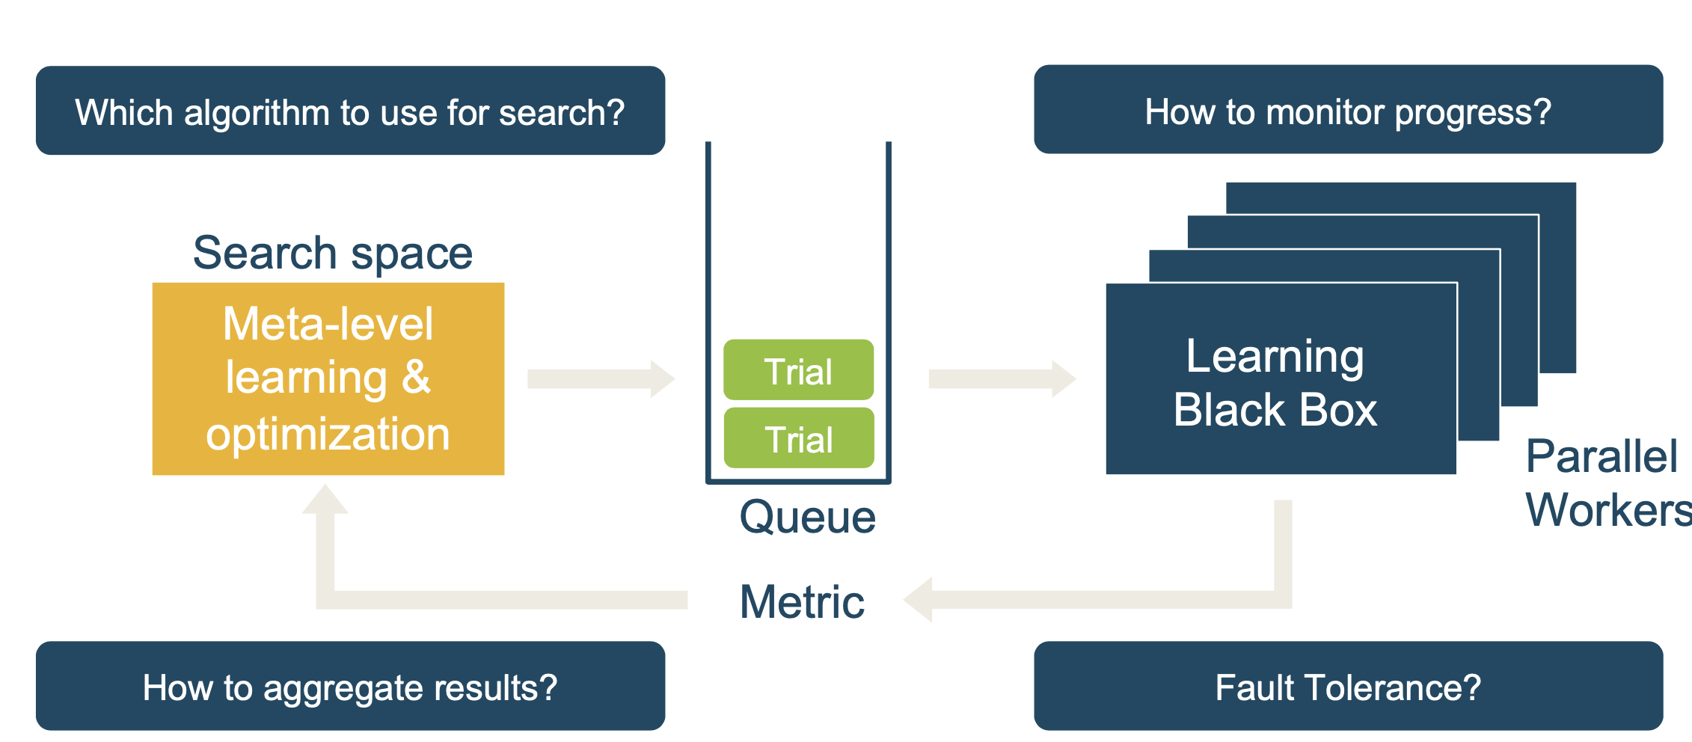
Parallel black box optimization

Slide 22
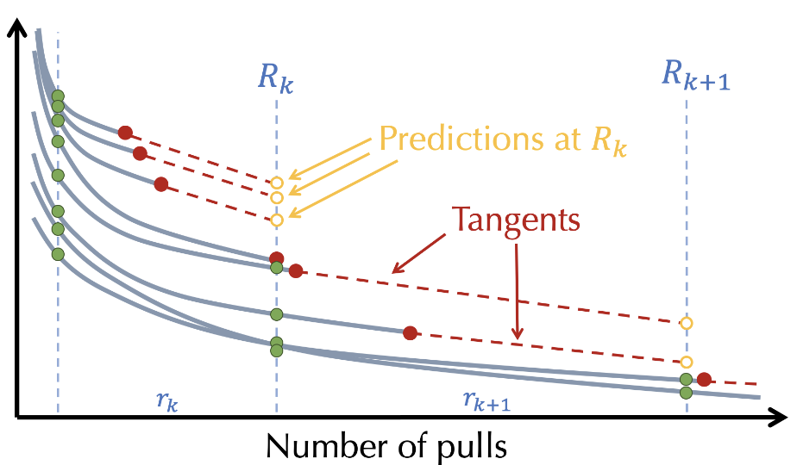
Principled early-stopping with Successive Halving
Successive Halving Algorithm (SHA):
Uniformly allocate a budget to a set of candidate hyperparameter configurations in a given rung (set of epochs).
Evaluate the performance of all candidate configurations.
Promote the top half of candidate configurations to the next rung.
Double the budget per configuration for the next rung and repeat until one configurations remains.

Slide 23
Asynchronous Successive Halving for the parallel setting
In the sequential setting, SHA evaluates orders of magnitude more hyperparameter configurations than random search by adaptively allocating resources to promising configurations. Unfortunately, it is difficult to parallelize because the algorithm takes a set of configurations as input and waits for all configurations in a rung to complete before promoting.
To remove the bottleneck created by synchronous promotions, the asynchronous successive halving algorithm (ASHA) grows from the bottom up and promotes configurations whenever possible instead of starting with a wide set of configurations and narrowing down.

Slide 24
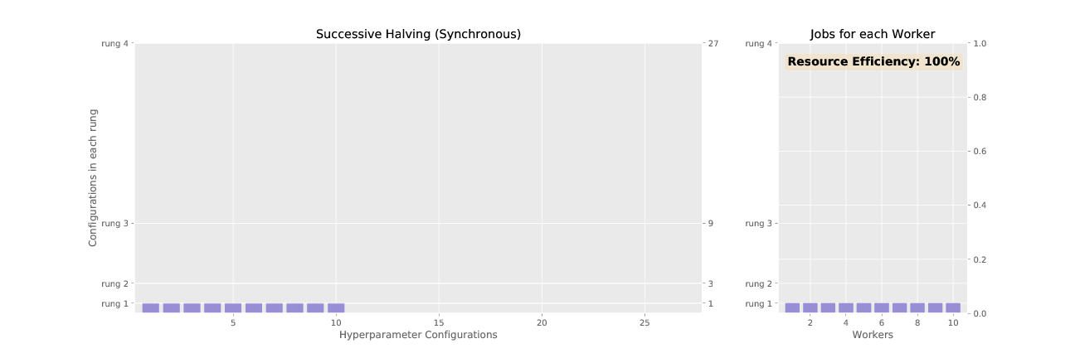
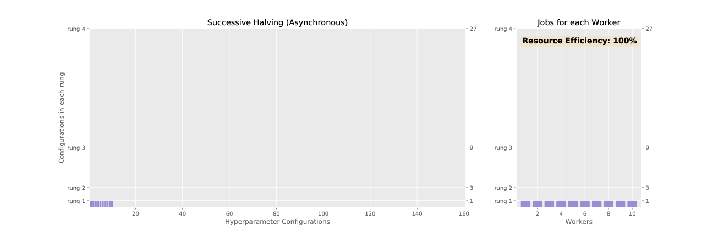
SHA & ASHA
ASHA begins by assigning workers to add configurations to the bottom rung. When a worker finishes a job and requests a new one, ASHA looks at the rungs from top to bottom to see if there are configurations in the top 1/η of each rung that can be promoted to the next rung. If not ASHA assigns the worker to add a configuration to the lowest rung to grow the width of the level so that more configurations can be promoted.
Figures animate the associated promotion schemes for SHA and ASHA when using 10 workers and the associated worker efficiency for each.
As shown in the top Figure, the naive way of parallelizing SHA, where each configuration in a rung is distributed across workers, diminishes in efficiency as the number of jobs dwindle for higher rungs.
In contrast, asynchronous SHA approaches near 100% resource efficiency
https://bit.ly/3KHH9pM

Slide 25
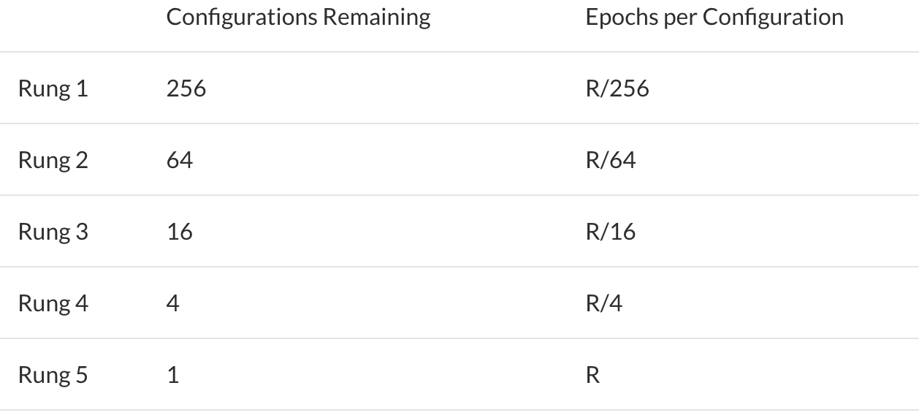
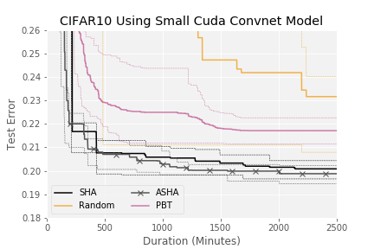
Small-scale benchmark: CNN on CIFAR-10
SHA and ASHA algorithm promote η=1/4 configurations to the next rung.
https://bit.ly/3KHH9pM

Slide 26

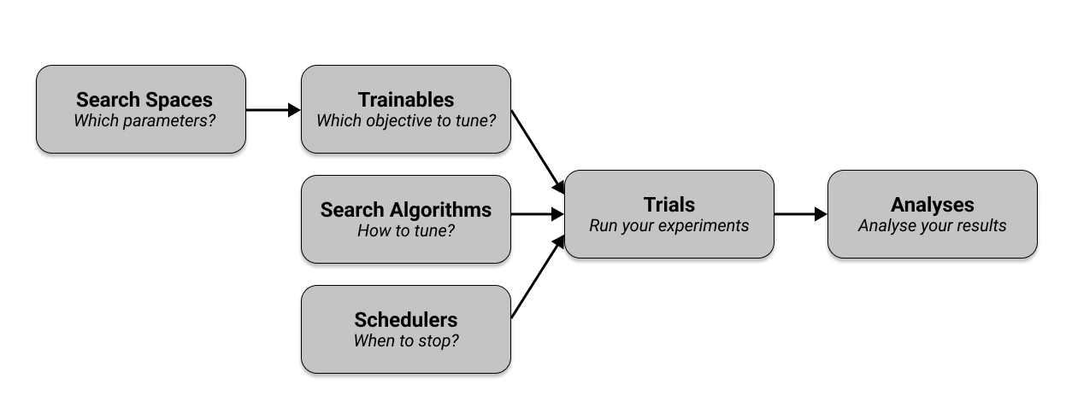
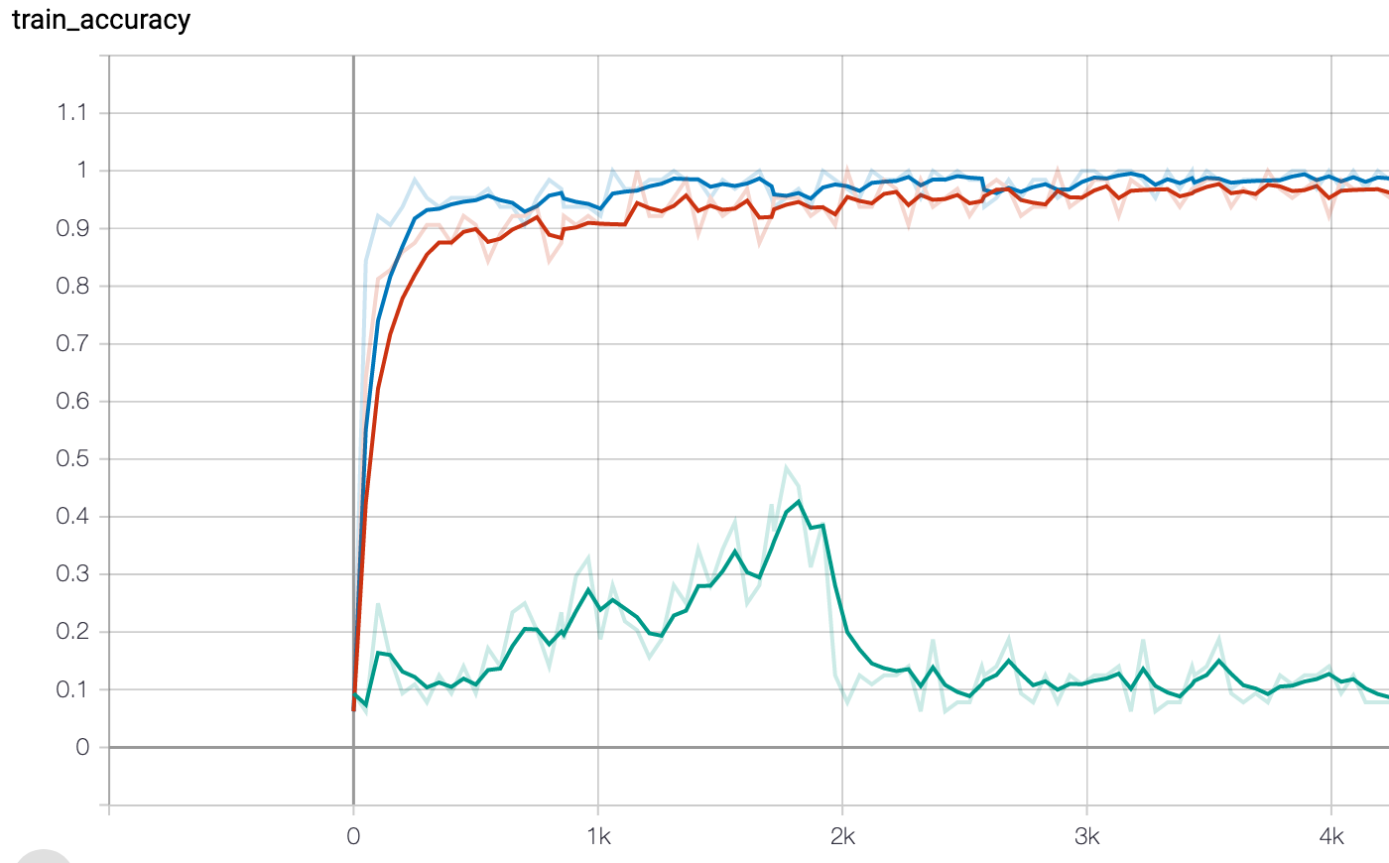
Ray[tune]
Tune is a Python library for experiment execution and hyperparameter tuning at any scale. You can tune your favorite machine learning framework (PyTorch, XGBoost, Scikit-Learn, TensorFlow and Keras, and more) by running state of the art algorithms such as Population Based Training (PBT) and HyperBand/ASHA.

Slide 27
<Ray tune optimization demo>

Slide 28
Wrap-up
Asynchronous SHA is massively scalable because it faces no degradation in performance when compensating for time with more parallel resources.
In contrast, Bayesian methods are hampered in wall-clock time constrained settings, since they require updates to the posterior to effectively select new configurations
For more details about the SHA and guarantees that the algorithm will not eliminate good configurations prematurely, see the paper.
For more details about the ASHA, an extended related work section, and more extensive empirical studies, see this paper.
Avoid iterative Hyperparameter Optimization
Black box optimisation is hard
State-of-the-art algorithms can be deployed asynchronously
Ray: platform support for automated hyperparameter optimization and ablation studies
Save resources with asynchronism

Slide 29
Network Architecture Search

Slide 30
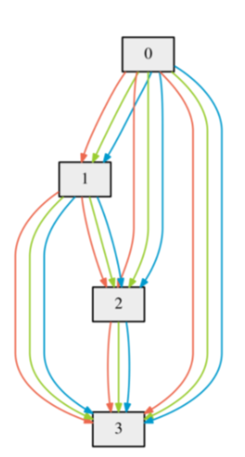
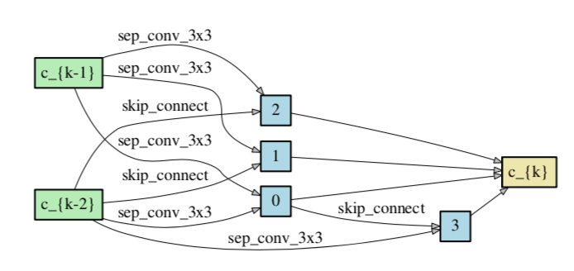
Basic idea
Search for network topology as a graph of nodes connected by operations.
For simplicity the whole network is split into sub-graphs (cells) connected to each other.
Connection between nodes and cells are parametrized (relaxed) by softmax operation
Liu, Hanxiao and Simonyan, Karen and Yang, Yiming, DARTS: Differentiable Architecture Search, 2018

Slide 31
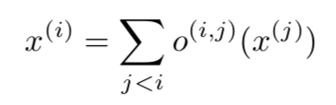
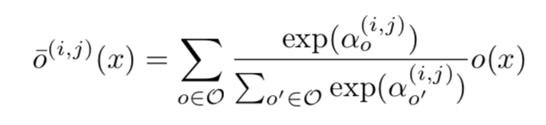
Structure of a cell[i]
0-th node is the output of cell[i-2], 1-st node is the output of cell[i-1]
All other nodes are connected to all of its predecessors through operations like convolution, pooling, identity, zero:
SoftMax of all possible operations:
Nodes are parametrized by 𝓌, connections are parametrized by ⍺

Slide 32
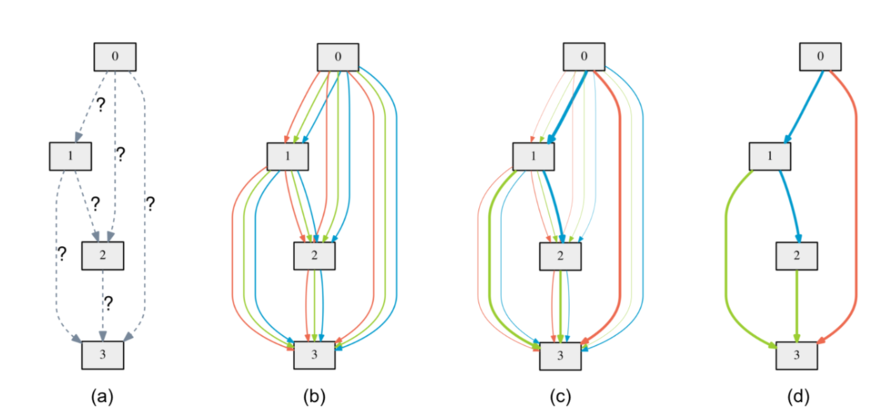
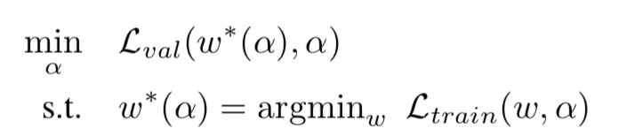
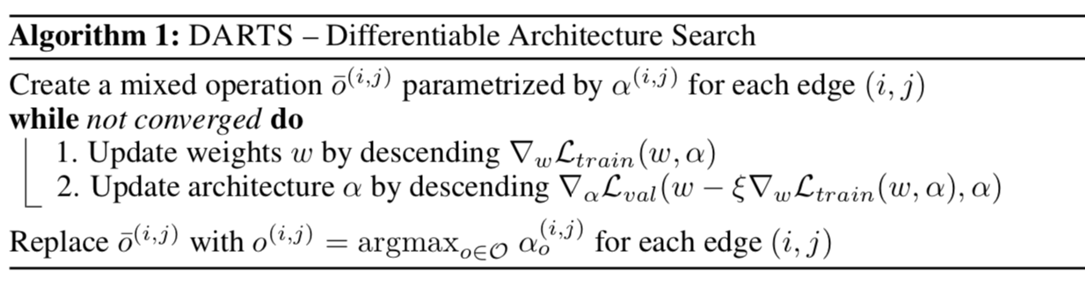
Cell optimisation procedure

Slide 33
Network structure
Initialise array of cells according to ‘genotype’ (specific cell structure trained before)
Connect each cell to two previous neighbors
Output of the final cell is the output of the network
Learn through backprop

Slide 34
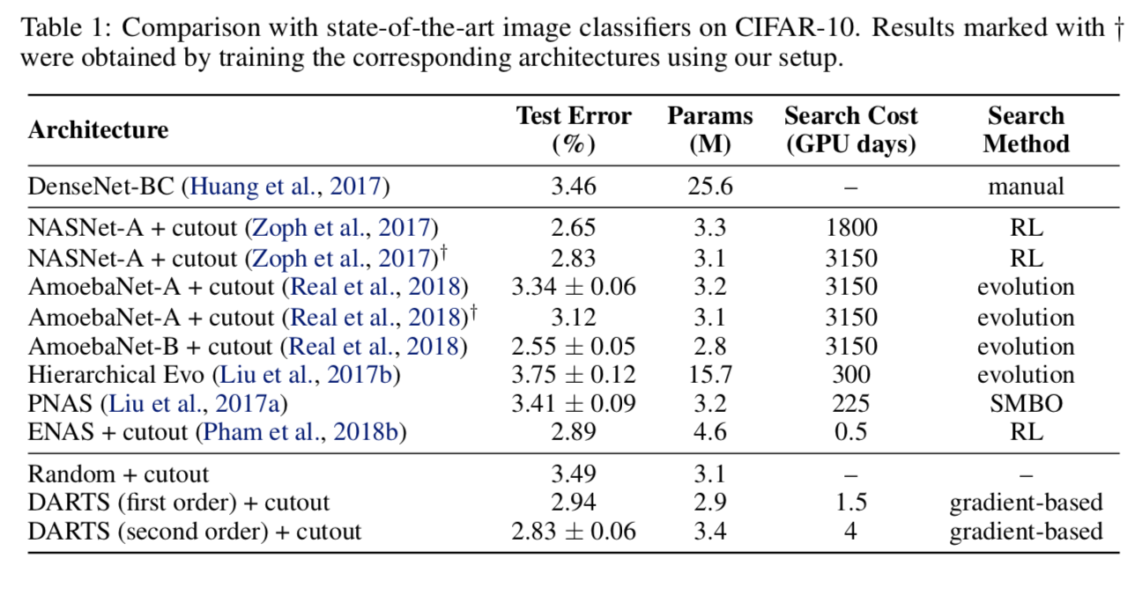
Discussion
Trains reasonable amount of time ~ 1 day on GTX 1080
Works both for CNNs and RNNs
No rigorous guarantees, but:

Slide 35
Play on your own
Original repository: https://github.com/NeroLoh/darts-tensorflow
PyTorch DARTS repository: https://github.com/dragen1860/DARTS-PyTorch
git clone <URL> ; cd DARTS-PyTorch nvidia-smi # check if you have GPU onboard mkdir exp python train_search.py <wait for genotype to evolve, add it to genotype.py> python visualize.py <NAME_OF_YOUR_GENOTYPE> python train.py －genotype <NAME_OF_YOUR_GENOTYPE>

Slide 36
Other approaches
Reinforcement learning Neural Architecture Search with Reinforcement Learning (Zoph and Le, 2016) NASNet (Zoph et al., 2017) ENAS (Pham et al., 2018)
Evolutionary algorithm Hierarchical Evo (Liu et al., 2017) AmoebaNet (Real et al., 2018)
Sequential model-based optimisation (SMBO) PNAS (Liu et al., 2017)
Bayesian optimisation Auto-Keras (Jin et al., 2018) NASBOT (Kandasamy et al. 2018)
Gradient-based optimisation SNAS (Xie et al., 2018) DARTS (Liu et al., 2018)
https://www.tensorflow.org/tutorials/keras/keras_tuner

Slide 37
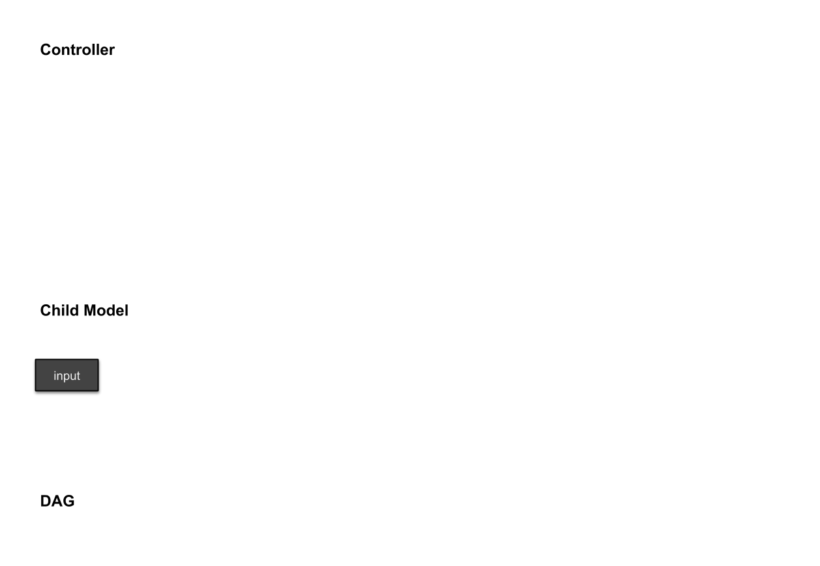
Other approaches
https://www.fast.ai/2018/07/16/auto-ml2/

Slide 38
Bayesian Perspective on Deep Learning

Slide 39
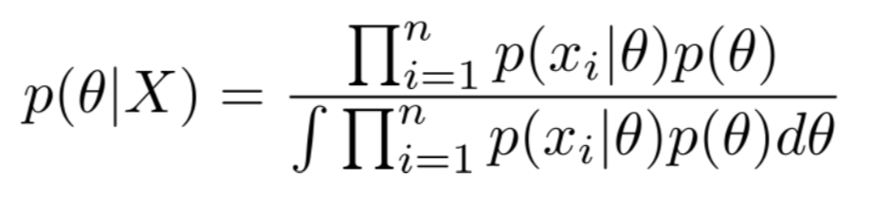
Highlights
What if instead of training a network via Maximum Likelihood (loss-function minimization), we could define a neural net as a tensor sampled from some distribution that we can get from the data?
We would be adopting a more Bayesian approach to neural networks. In this approach, rather than learning point estimates for the model parameters, we attempt to learn full distributions over the neural network weights.

Slide 40
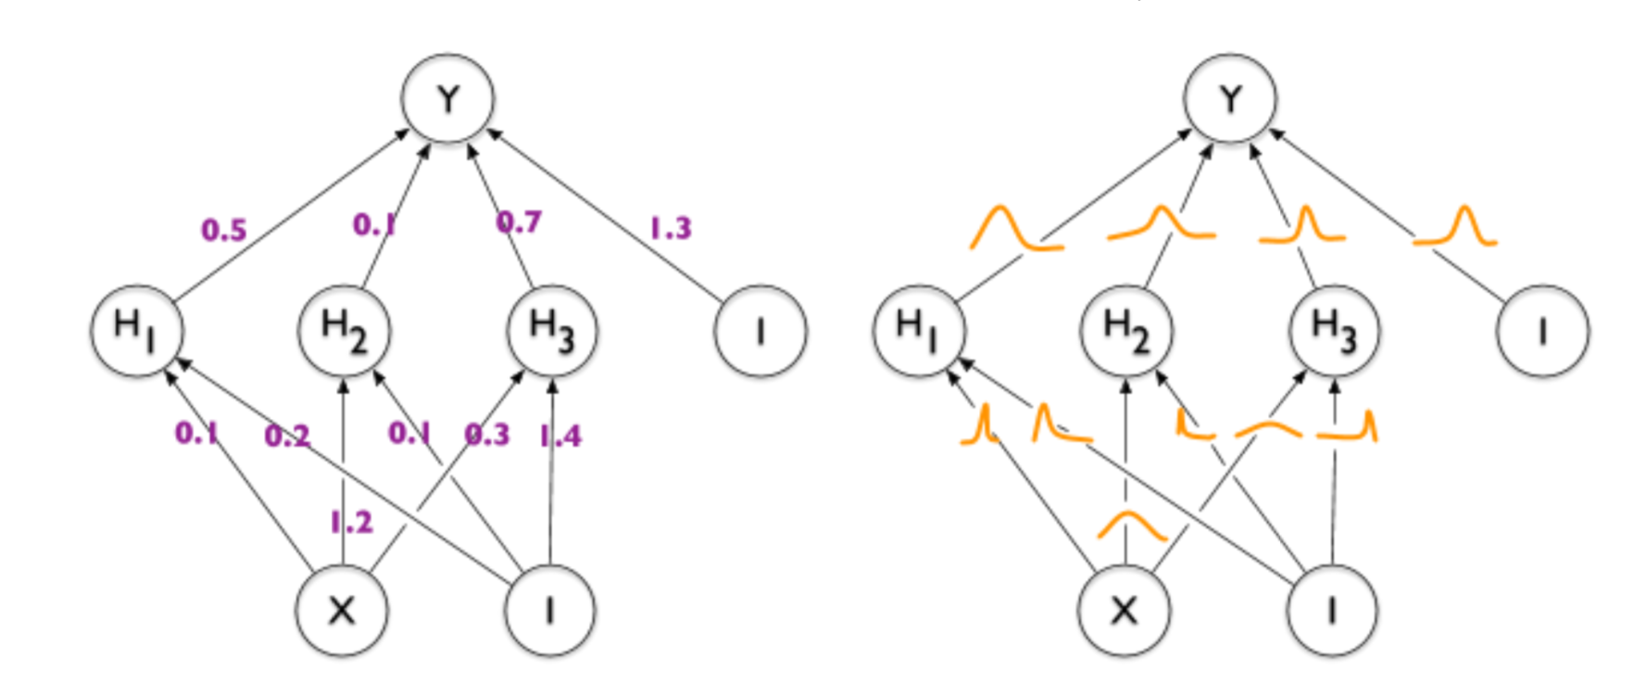
Bayesian Neural Networks
Bayesian Neural Networks (BNNs) model the uncertainty in the weights through probability distributions. By learning the posterior distribution over the network weights given the data, we can obtain more robust predictions with a quantified uncertainty. This could lead to more reliable and cautious decisions, especially in safety-critical applications or when dealing with limited or noisy data.

Slide 41
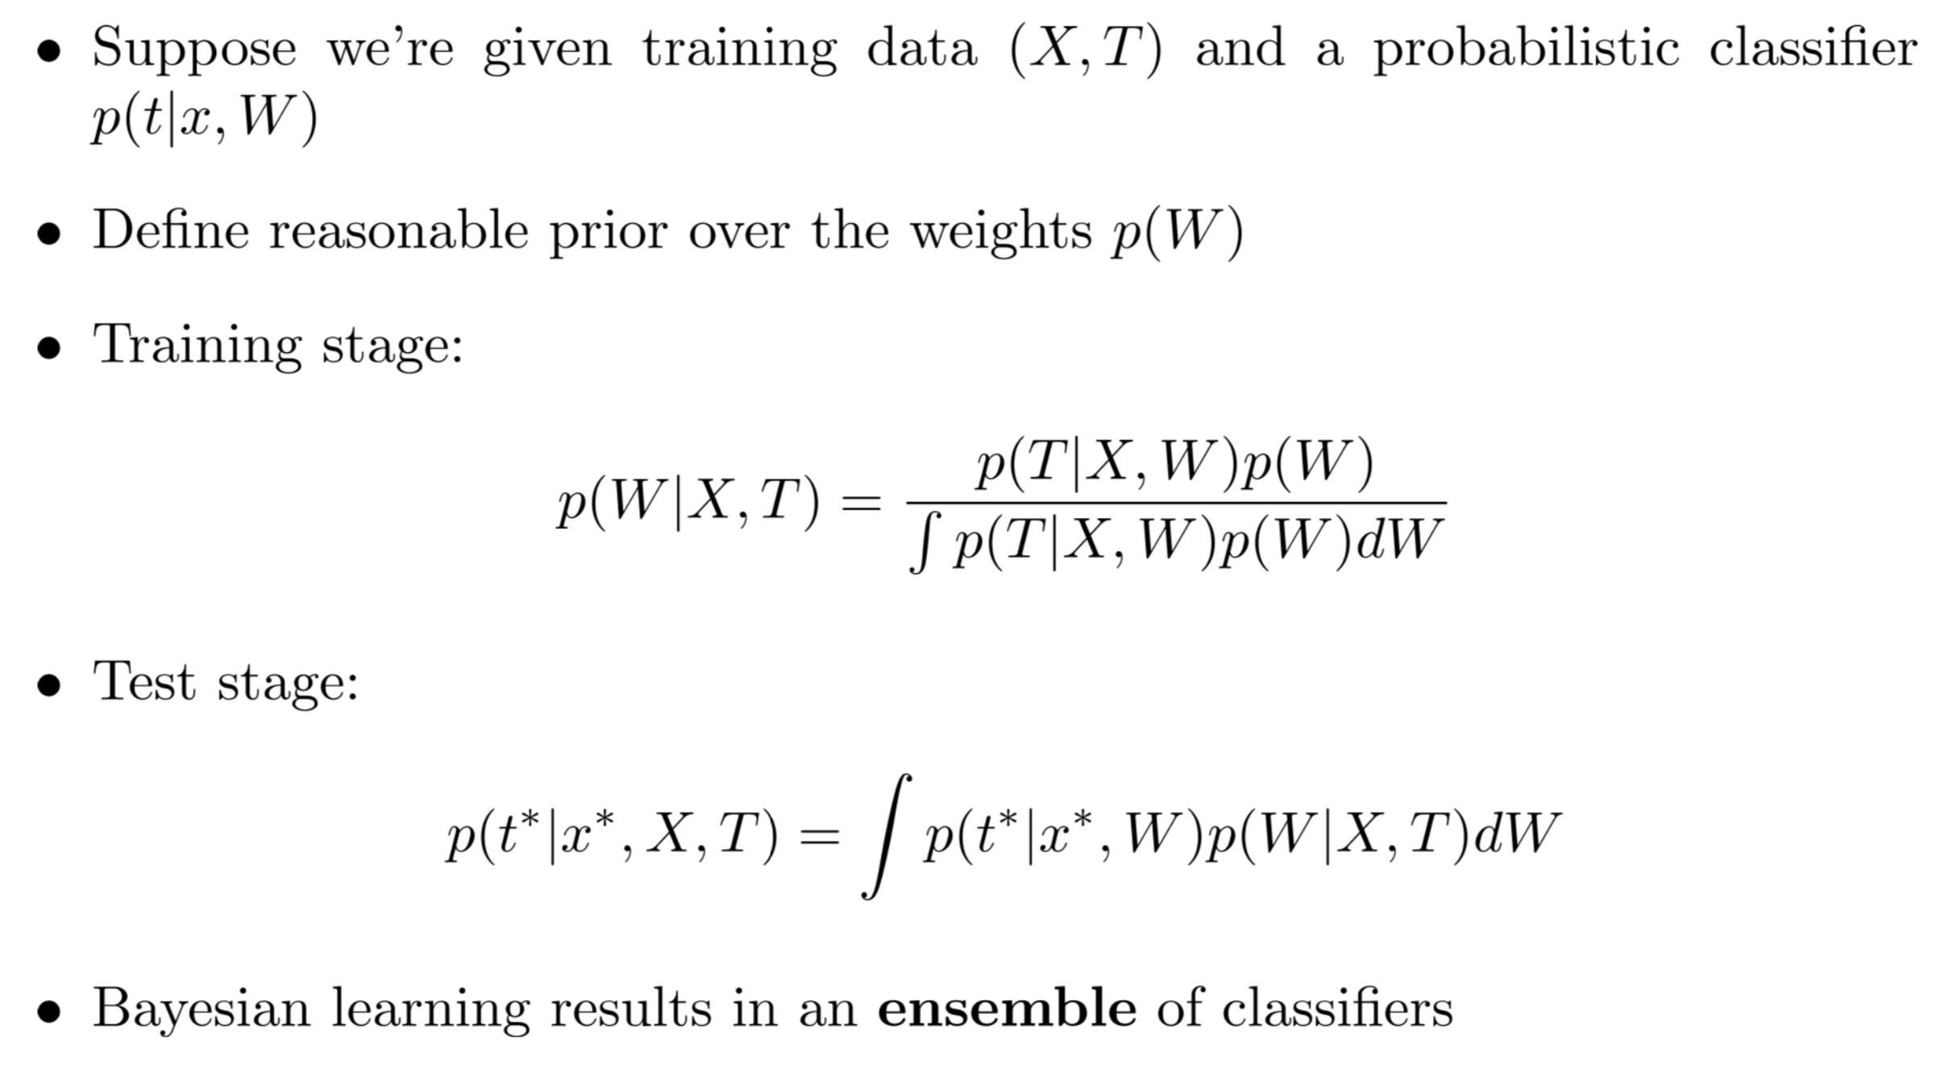
Bayesian Machine Learning

Slide 42
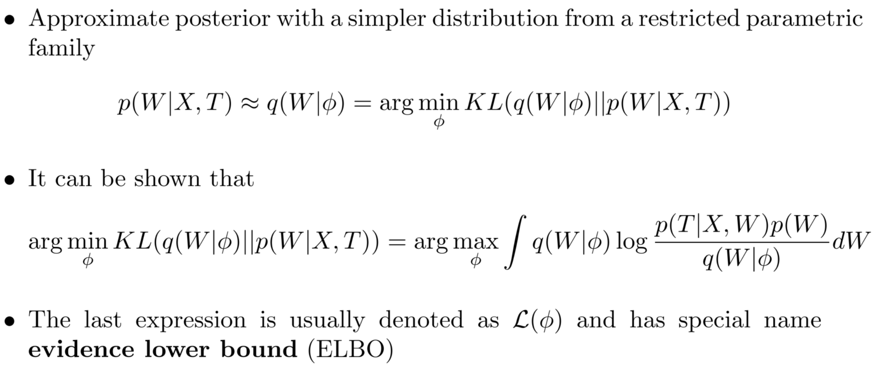
Variational Trick

Slide 43
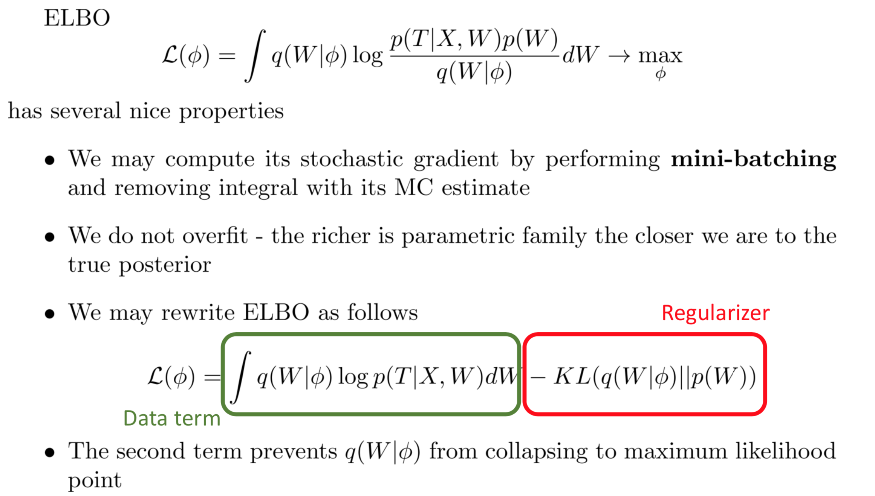
ELBO properties

Slide 44
Bayesian Neural Network representation
Standard Neural Net
Bayesian Neural Net

Slide 45
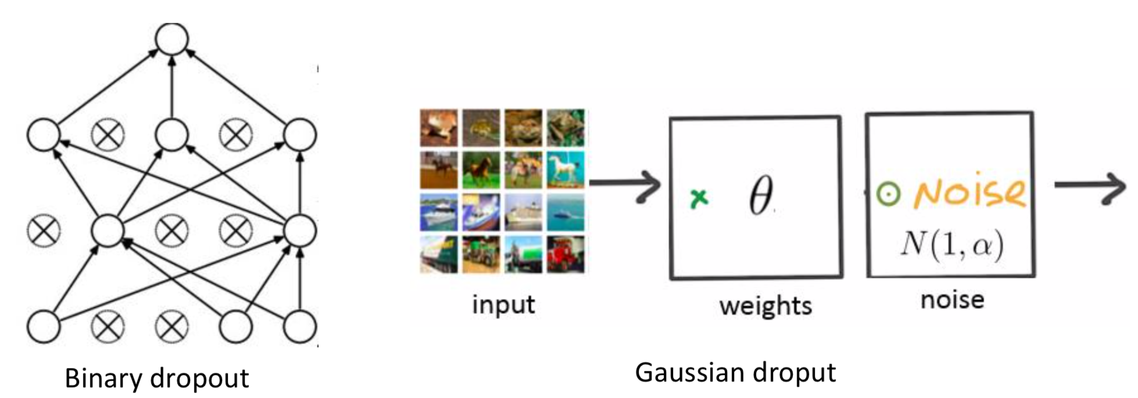
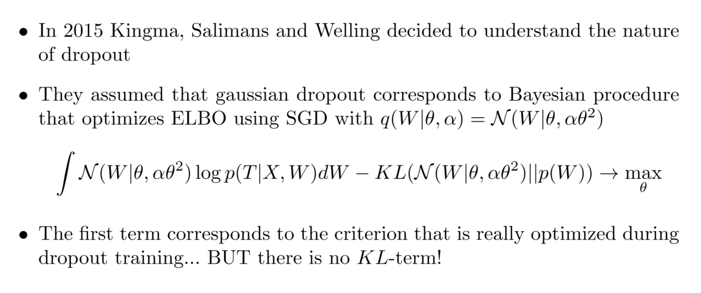
Dropout reinvented

Slide 46
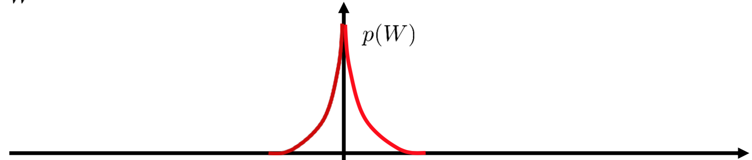
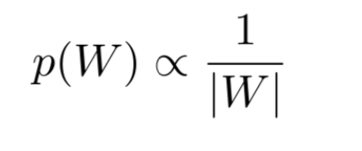
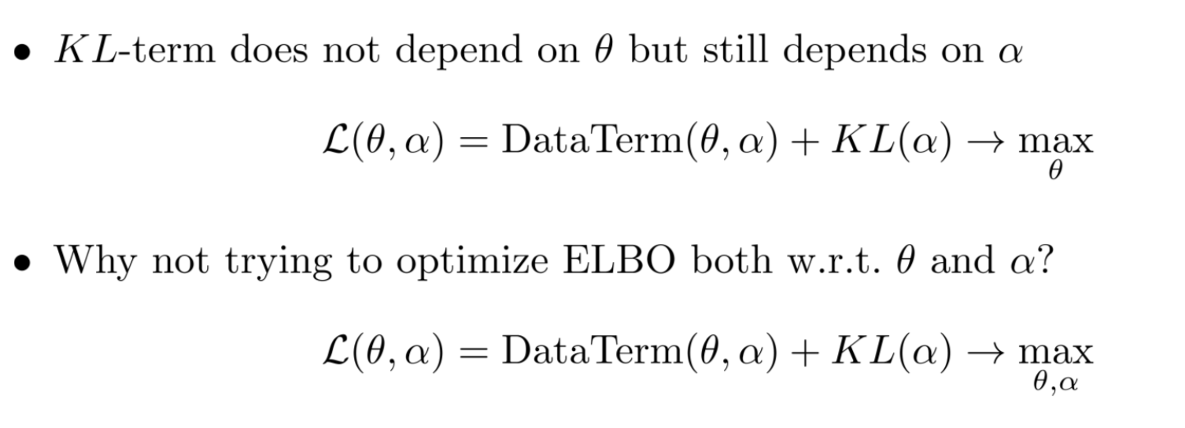
Variational Dropout

Slide 47
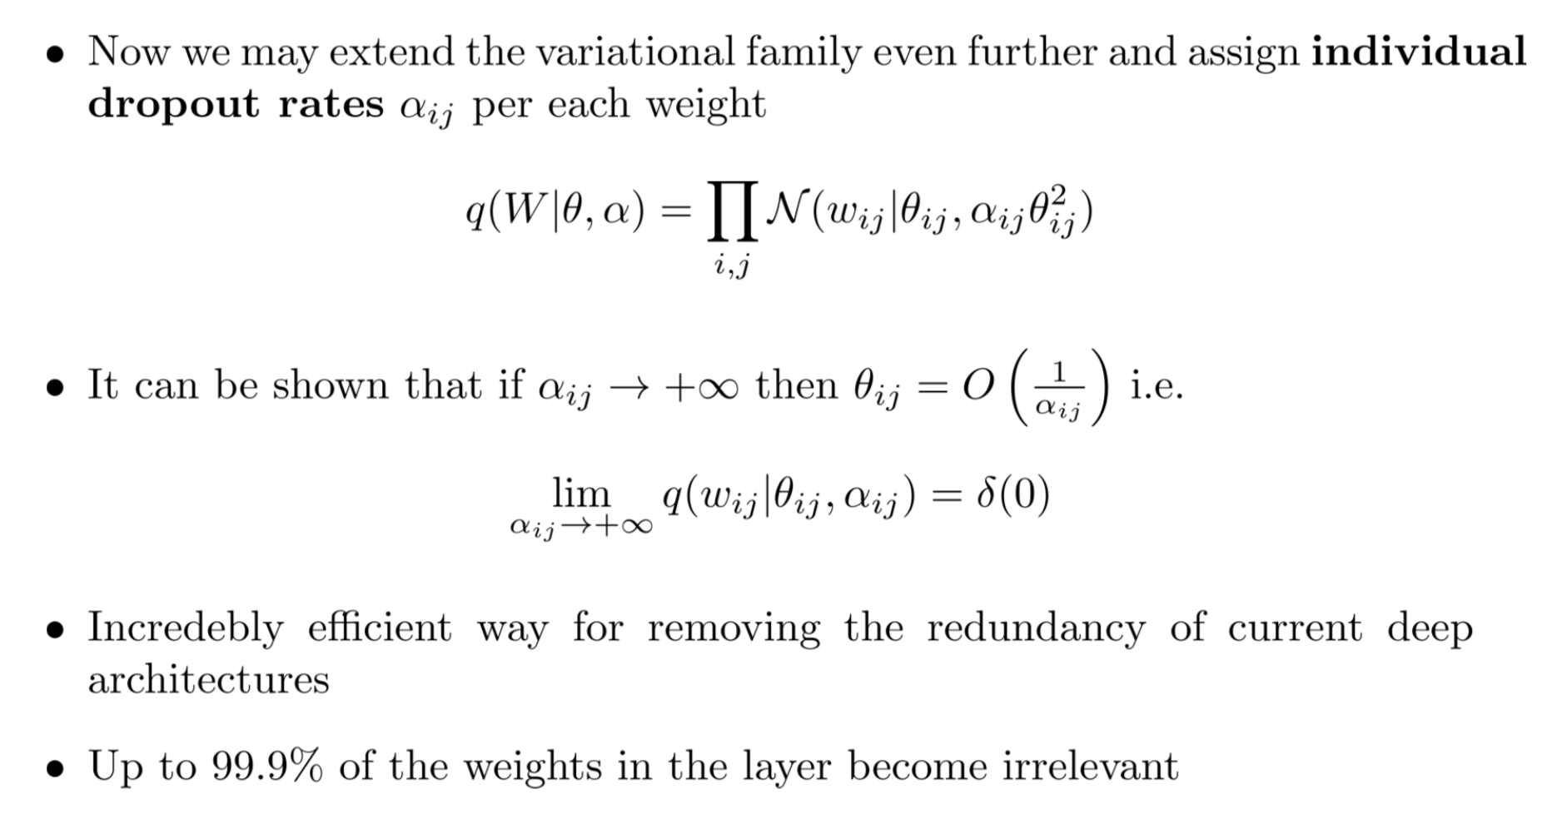
Sparse Variational Dropout
Dmitry Molchanov, Arsenii Ashukha, Dmitry Vetrov. Variational Dropout Sparsifies Deep Neural Networks. ICML 2017.

Slide 48
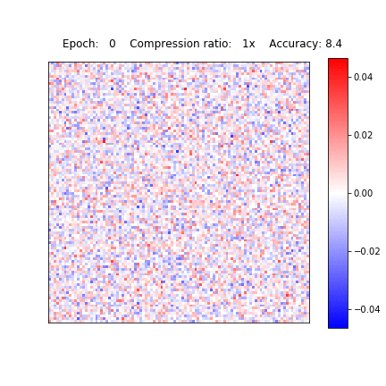
Visualisation

Slide 49

Comparison

Slide 50


Simultaneous pruning and quantization
Simultaneous pruning and quantization of weights - ternary codebook
Quantizing prior: “multi-spike-and-slab”
Variational Network Quantization, Achterhold et al., ICLR 2018

Slide 51

Simultaneous pruning and quantization
Standard Training
Variational Network Quantization
Variational Network Quantization, Achterhold et al., ICLR 2018

Slide 52


Simultaneous pruning and quantization
Prune weights with small expected value or large variance
Quantize by assigning weights to closest quantization level
Variational Network Quantization, Achterhold et al., ICLR 2018

Slide 53

More details
To learn the posterior distribution over the weights,
we need efficient Bayesian inference techniques.
As exact inference methods are generally intractable
for deep learning problems, approximate inference
methods, such as Variational Inference, Markov
Chain Monte Carlo, or Stochastic Gradient
Langevin Dynamics, are employed.
While Bayesian approaches to neural networks
can provide compelling benefits by quantifying the
model uncertainty, they often come with increased
computational cost and complexity, making them
less practical for certain large-scale applications.
https://www.youtube.com/watch?v=TD2PF6TZcx0 https://www.youtube.com/playlist?list=PLe5rNUydzV9Q01vWCP9BV7NhJG3j7mz62

Slide 54

Discussion
Bayesian framework is extremely powerful and extends ML tools
Impossible to overtrain, since more parameters -> better W distribution!
Bayesian NN is an ensemble, hence uncertainty estimation is easier
Scalable algorithms for approximate Bayesian inference are already available
Easily accounts for additional objectives (compression, quantization)
Quite breathtaking mathematical development

Slide 55
Conclusion
Optimisation of a learner (e.g., neural network) is not a merely technical procedure
Sampling: GridSearch, RandomSearch, BayesianSearch, …
Parallel scheduling: SHA, ASHA, …
Neural architecture search: tricky definition of the design space
Bayesian Neural Networks: learning weights distributions instead of point estimate
Future directions: inclusion of hardware in the optimization loop
Specification
Simulation

Slide 56




Thank you!
andrey.ustyuzhanin@constructor.org
anaderiRu
Andrey Ustyuzhanin
Notes:
And I will be more than happy to address your questions during the forthcoming seminar.

Slide 57
Moar interesting stuff
Ternary quantization https://github.com/TropComplique/trained-ternary-quantization/tree/master/ttq_densenet_small
The State of Sparsity in Deep Neural Networks, https://arxiv.org/pdf/1902.09574.pdf
Information Bottleneck: https://github.com/ravidziv/IDNNs
https://github.com/ray-project/ray
https://github.com/keras-team/autokeras , https://arxiv.org/pdf/1806.10282.pdf
The Lottery Ticket Hypothesis… https://arxiv.org/abs/1803.03635

Slide 58

Frequentist vs Bayesian

